Slide 1

General Wellness

Slide 2

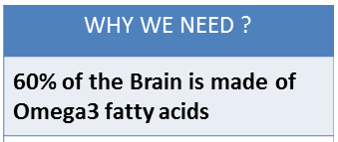
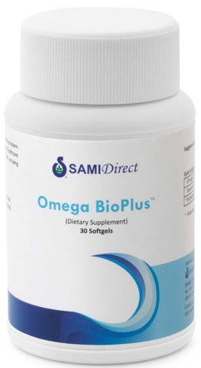

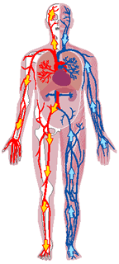

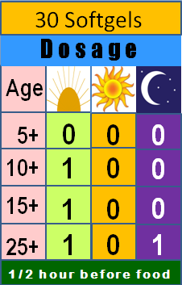
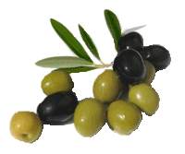
General Wellness
Provides Nutrition for blood & nerves
Agase beeja
Sl. No. | Omega fatty acids | Percentage (%)
1 | Omega 3 fatty acids | 40 - 60
2 | Omega 6 fatty acids | 5 - 20
3 | Omega 9 fatty acids | 15 - 30
Olives

Slide 3
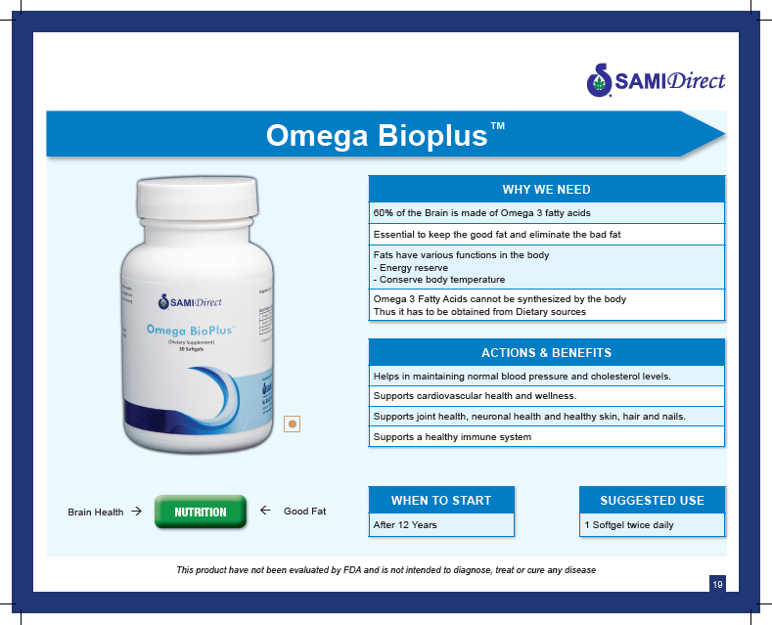
General Wellness

Slide 4
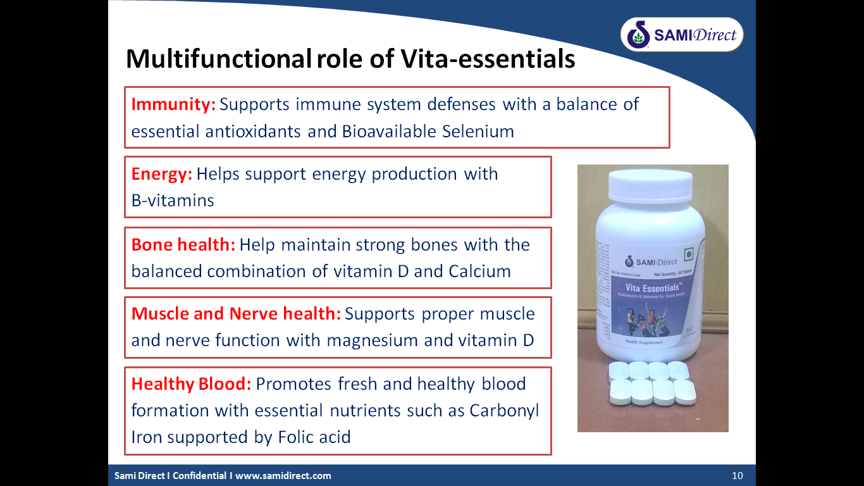
General Wellness
Unique blend of multivitamin and mineral complex, made more effective with the addition of “bioavailability enhancers”
“Vita-essentials”
Vitamin B1
Vitamin B2
Vitamin B5
Vitamin B6
Vitamin B12
Biotin
Vitamin A
Vitamin D3
Vitamin E
Selenium Select
Calcium Citrate Malate
Magnesium Citrate
Vitamin B3
Folic Acid
Copper Lysinate
Manganese Glycinate
…

Slide 5
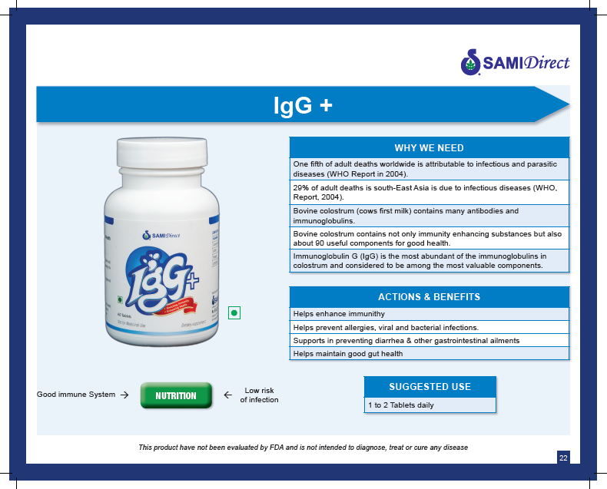

Immune booster

Slide 6


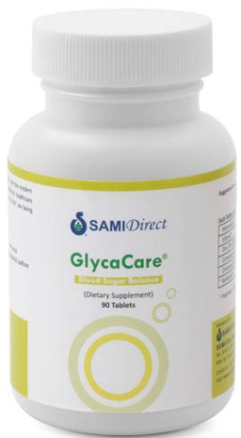
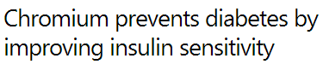


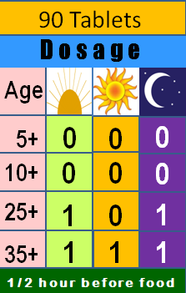
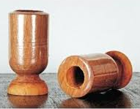
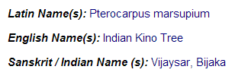
Special care
Healthy Management of Diabetes
SILBINOL(kino tree)
(Kempu Honne Mara)

Slide 7
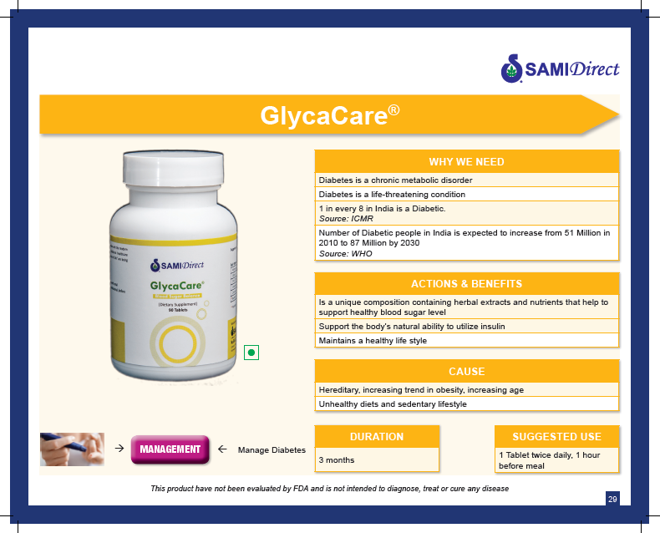
Special care

Slide 8

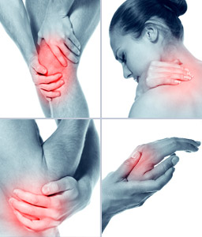
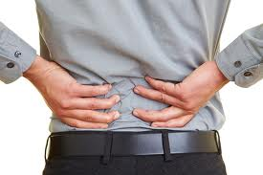
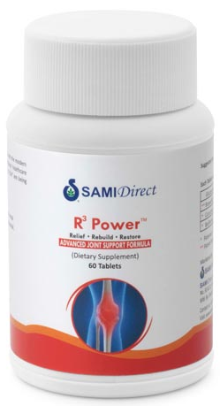
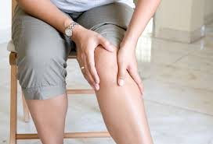

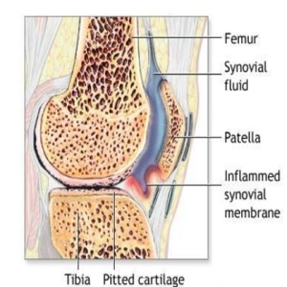

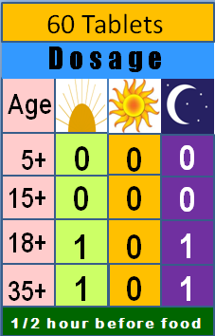
Relief, Rebuilds, Restores
Guggula Mara
Boswellia
Glucosamine
Curcumin

Slide 9
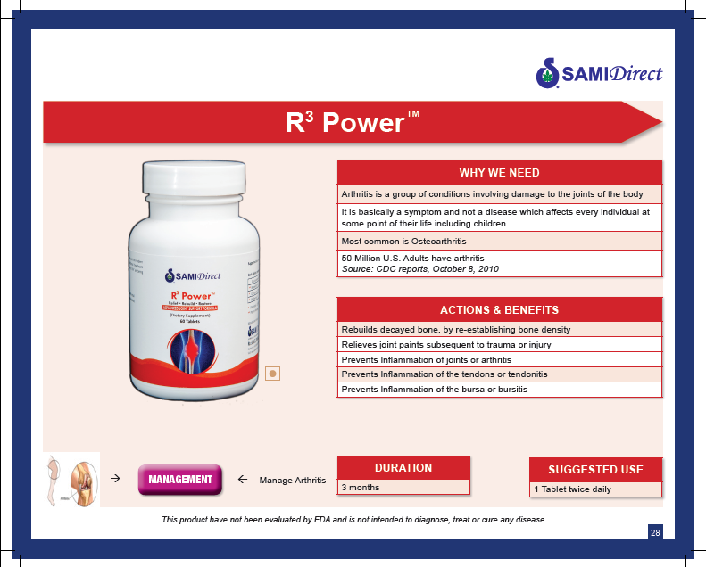
Special care

Slide 10
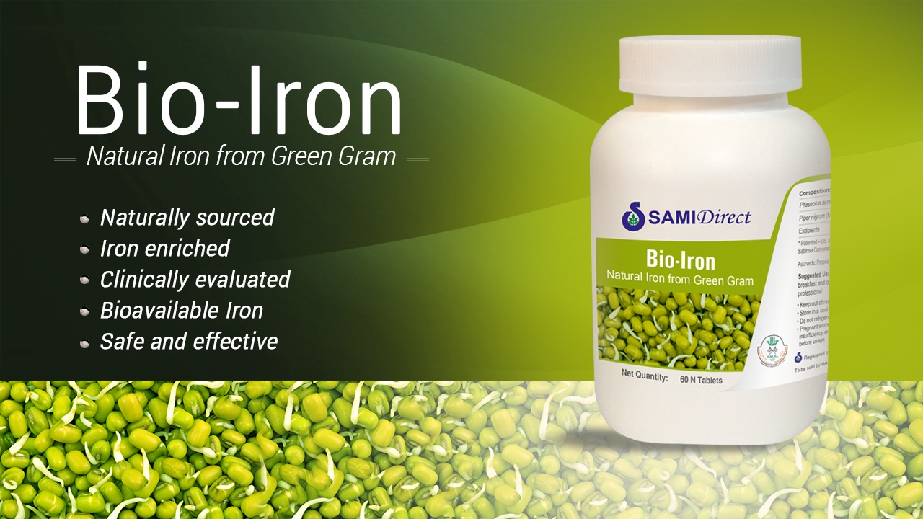
Special care

Slide 11

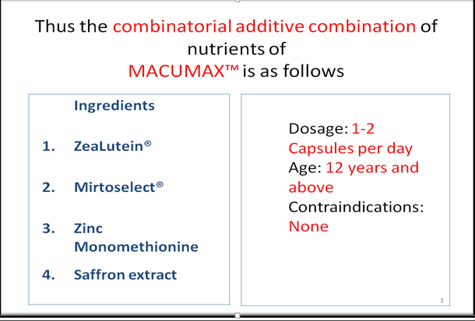
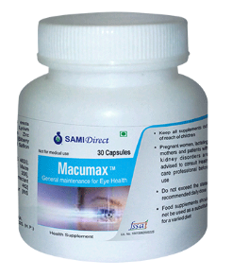
Special care

Slide 12
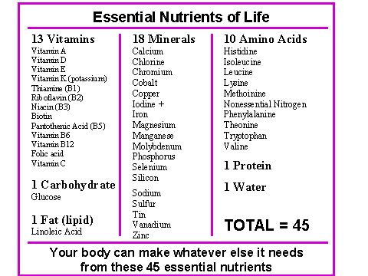
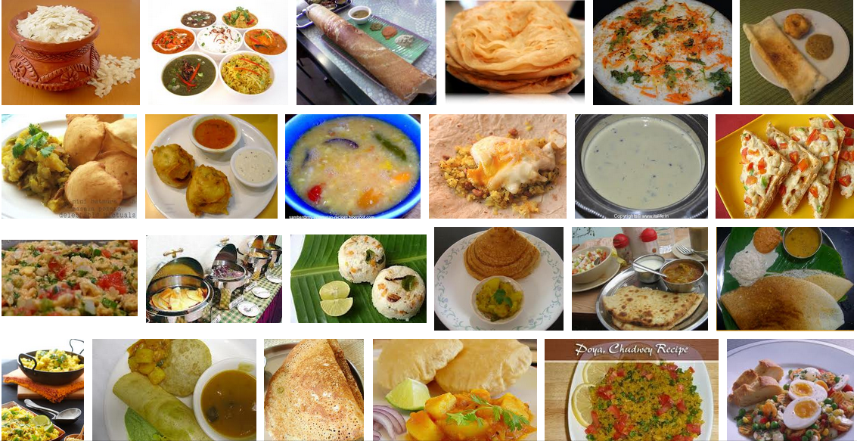


Morning - It is time for breaking the Fast !!!
Our body wakes up in the morning and demands 46 essential nutrients …
IN THE FORM OF
CARBOHYDRATES

Slide 13
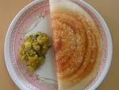
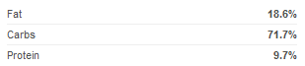
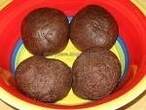
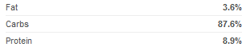
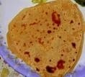
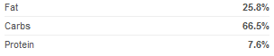
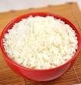
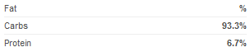

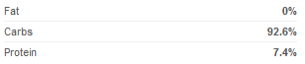
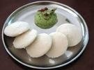
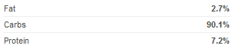

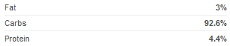
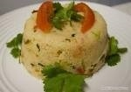
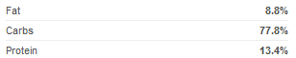
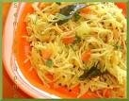
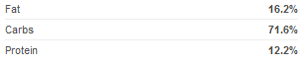
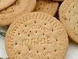
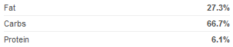
% of Calories from INDIAN FOODS
71.7%
87.6%
66.5%
93.3%
92.6%
90.1%
92.6%
77.8%
80% Calories from Carbs
66.7%
71.8%

Slide 14



Carbohydrates-filled breakfast is the cause of …
Average Indian Breakfast Contains 500 to 700 Calories.
70-80% Energy in our breakfast is from carbohydrates.

Slide 15

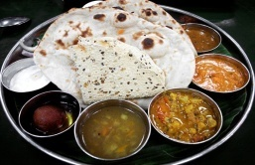
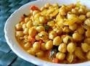
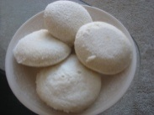
Daily Cycle of Fat Storage
Glucose
Insulin
High
Blood Sugar
High Insulin levels (no FBZ created)
High Insulin levels (no FBZ created)
Excess calories stored as fat.
Excess calories stored as fat.
Low
Blood Sugar
Dependency on Carbs for hunger
Dependency on Carbs for hunger
Breakfast
Morning Snack
Lunch
Snack

Slide 16
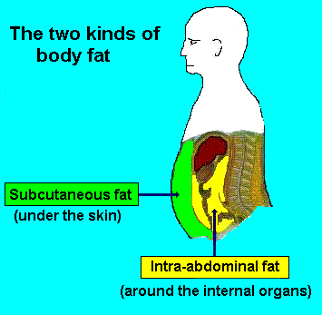
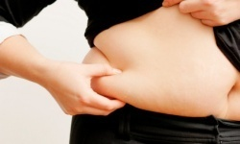
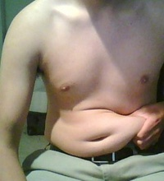


Two Kinds of Body Fat

Slide 17


Visceral Fat – a Toxic Asset

Slide 18






Slide 19








Proteins from Indian Breakfasts
< 25% of Daily Protein Requirement

Slide 20



Too Little Protein Means Muscle Loss
Protein is not stored in the body as such, unlike fat (in fat cells) and glucose (in muscle or liver). Because muscles, for example, are built from protein, we need to consume, and synthesize, enough protein to maintain healthy, hard-working muscles.
Recommended Dietary Allowance (RDA) for Protein Daily Protein Intake.
A minimum daily intake of protein is about 1.2 grams per kilogram of body weight

Slide 21





Our daily ‘normal’ BREAKFAST
EXCESSES
Salt, sugar, fats, calories, carbohydrates
Vitamins & minerals,
protein, fiber, water
DEFICIENCIES

Slide 22













Burns Excessive Fat
Stops New Fat Formation
22

Slide 23


Slide 24

Weight management
Change Your Breakfast, Change Your Life
Prevent Diabetes, Obesity, & Heart Diseases

Slide 25



Weight management
LEANGARD PROTEIN DRINK MIX
DI BLEND*

Slide 26


Slide 27


Contains Maximum Nutrients
46 Essential Nutrients
Nutrition is what our body needs on a daily basis to stay healthy.
MACRO NUTRIENTS FOR ENERGY DURING DAY
MICRO NUTRIENTS FOR CELL REPAIR DURING NIGHT

Slide 28




LeanGard Protein Drink (IDEAL MEAL)

Slide 29









Contains minimum calorie
180 CALORIES
LeanGard
Protein Drink
provides Reduced Calories with Maximum Nutrition
870 CALORIES

Slide 30


It is not what you eat that counts
It is what your body absorbs that counts
DI BLEND*

Slide 31
Maximum Bioavailability
Digestive Intolerance Blend – DIB*
Ingredient | Benefits
Protease | Improves protein digestion Prevents protein allergy/intolerance
Lactase | Improves digestion of milk sugar, lactose Beneficial for lactose intolerant individuals
LactoSpore® | Prevents infection in the gut Probiotic (Reduces load on the kidneys)
DI BLEND*

Slide 32












Slide 33



Slide 34


Slide 35


Slide 36










Women health
Prevents
Urinary Tract Infection
Cranberry

Slide 37

Women health

Slide 38








Women health
Prevents
Degeneration
of Bones in WOMEN
PHYTOESTROGENS
Soy extract
Red clover extract

Slide 39

Women health

Slide 40

Cosmeceutical Products
29

Slide 41


Slide 42


Slide 43


Slide 44


Slide 45


Slide 46


Slide 48


Slide 49


Slide 50


Slide 51


Slide 52


Slide 53


Slide 54


Slide 55


JOHARA NAIL COLOERS
MATTE
GLOSSE

Slide 56



Slide 57



Slide 58

Thank you for your time and attention
We Wish you…………

